Slide 1
AM_Fungi genome annotation
Would you like another layout for your title slide? There’s a number of options that you access via the “Layout” button or the “New slide” arrow.
SMS_5123
Nima Rafati

Slide 2
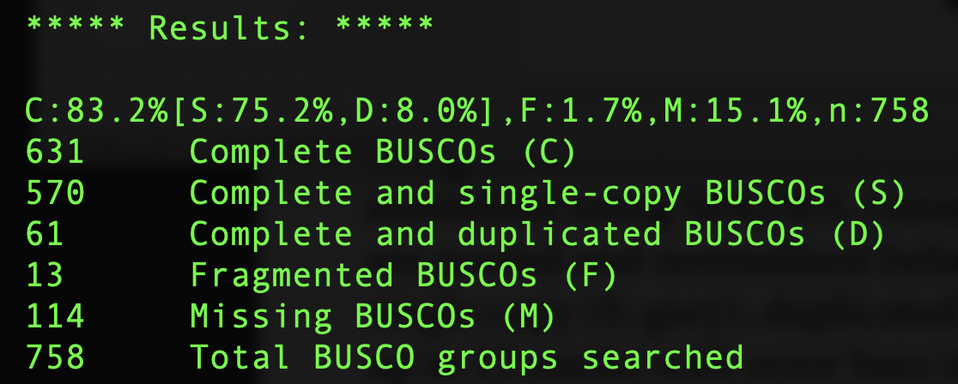
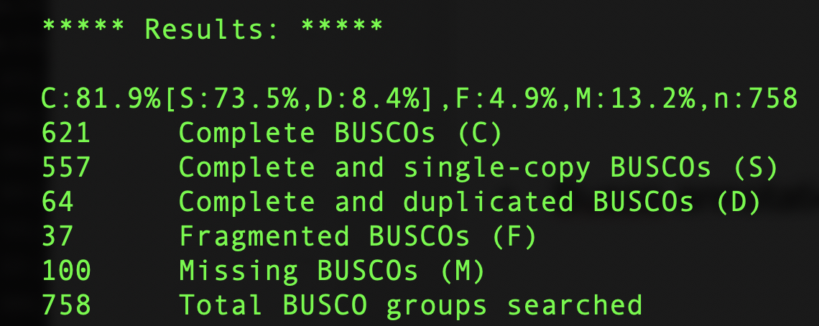
BUSCO: fungi_obd10
BUSCO genome:
Busco annotation:

Slide 3
RNA_Seq data
36 mRNA:
GC content

Slide 4
Assembly
Identical sequences
Potentially 17 scaffolds >90% similarity
scaffold_790
Scaffold_3518

Slide 5
Analysis outline
Adding color to something? The SciLifeLab brand colors are included in this templates’ “Theme colours”, found at the top row when opening the colour palette.
43 RNA-seq samples (fungi + Sorghum)
QC
FastQC: Reads seem to have high quality; first 10 bases are clipped due to bias GC content (barcodes). Two modes in GC content ➔ Two species (AM_Fungi + Sorghum)
rRNA: Cannot be run because rRNA are not annotated
Alignment and transcriptome assembly
QC
StringTie
Expression
Intersect assembled transcript with regions of interest

Slide 6
Analysis outline
Adding color to something? The SciLifeLab brand colors are included in this templates’ “Theme colours”, found at the top row when opening the colour palette.
Mapping reads to Sorghum and AM_Fungi separeately
STAR
GSNAP
Assigning the reads with better mapping to corresponding genome
Disambiguate
XenofilteR
QC of the mapping
QoRTs

Slide 7
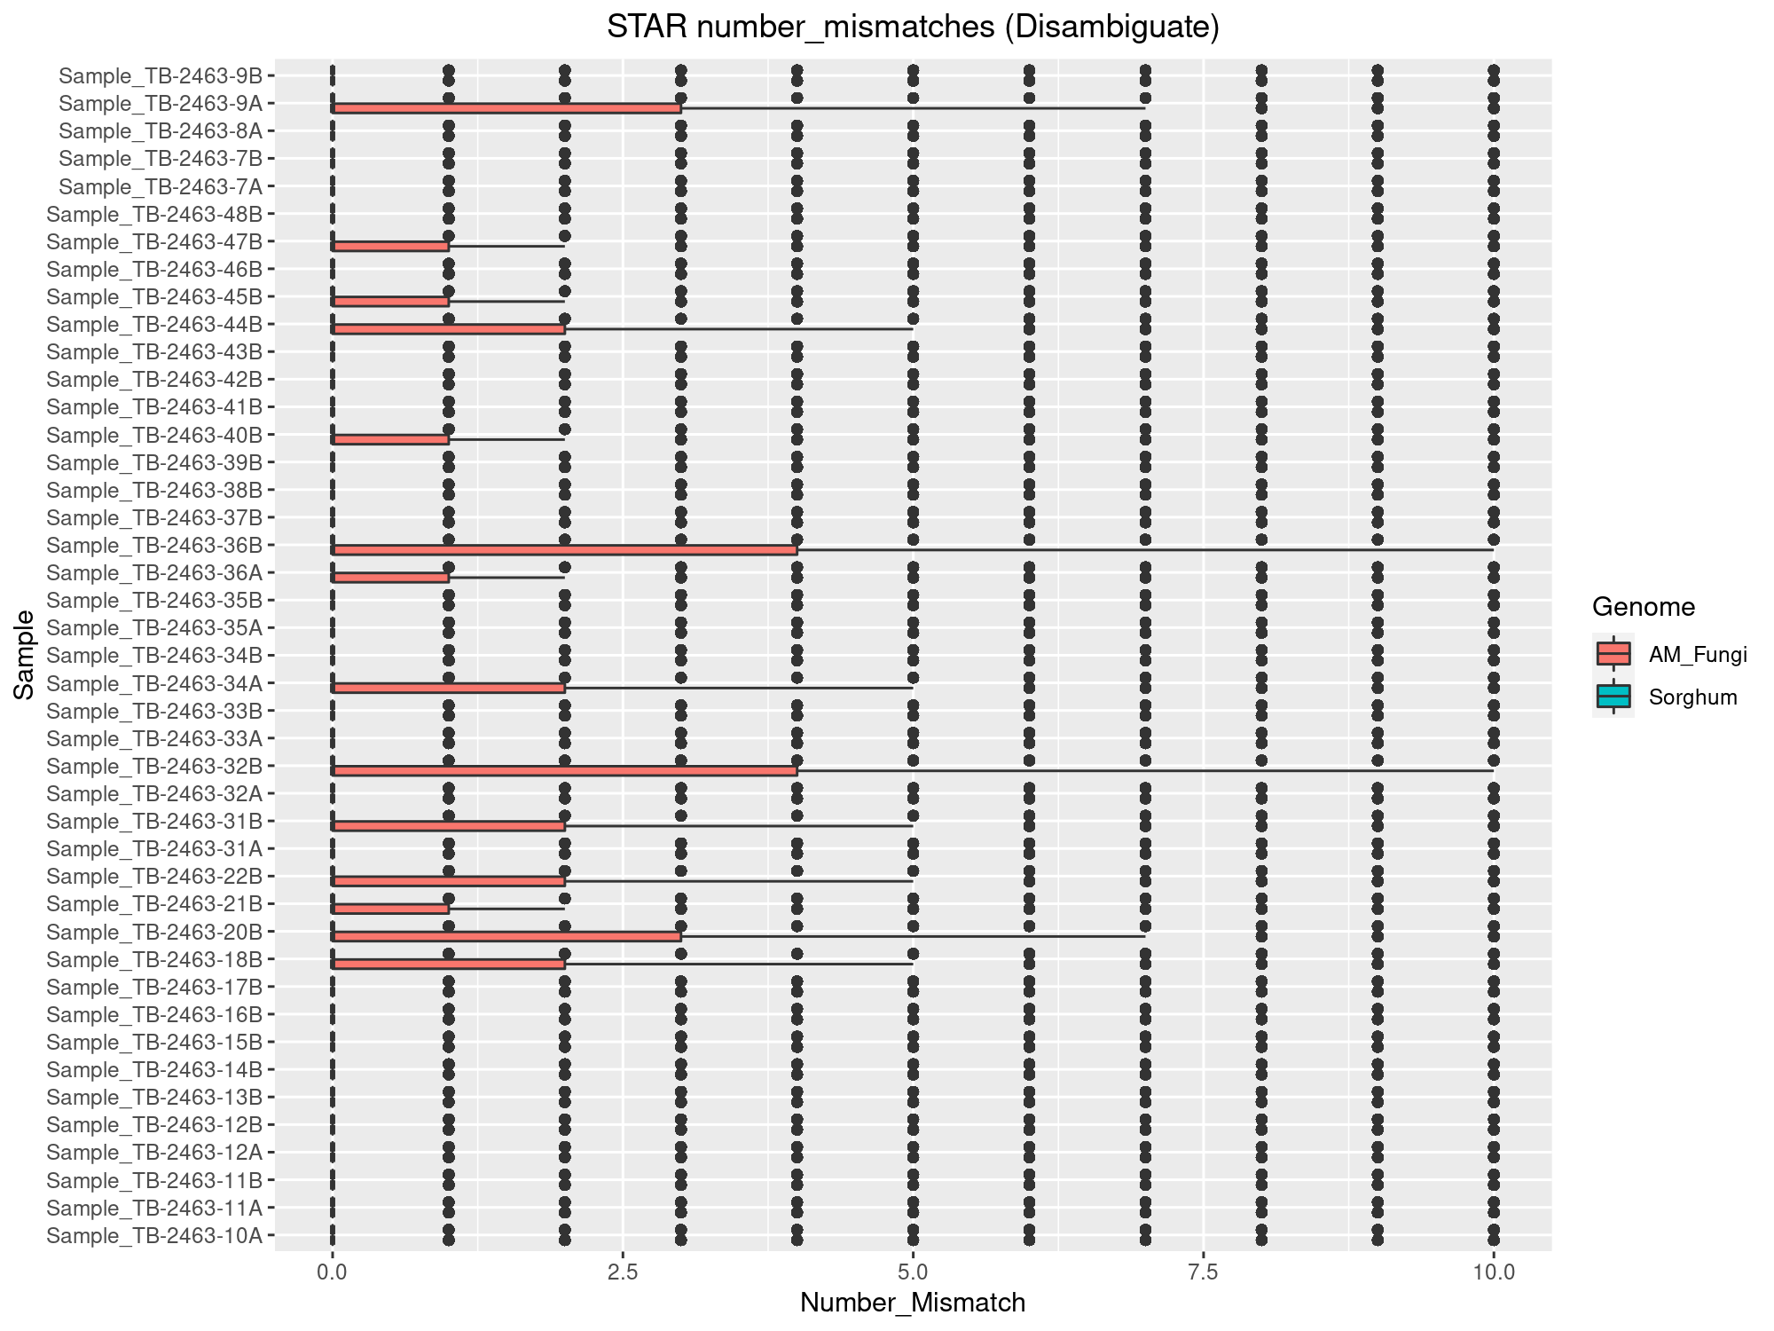
STAR ➔ Disambiguate ➔ QoRTs

Slide 8
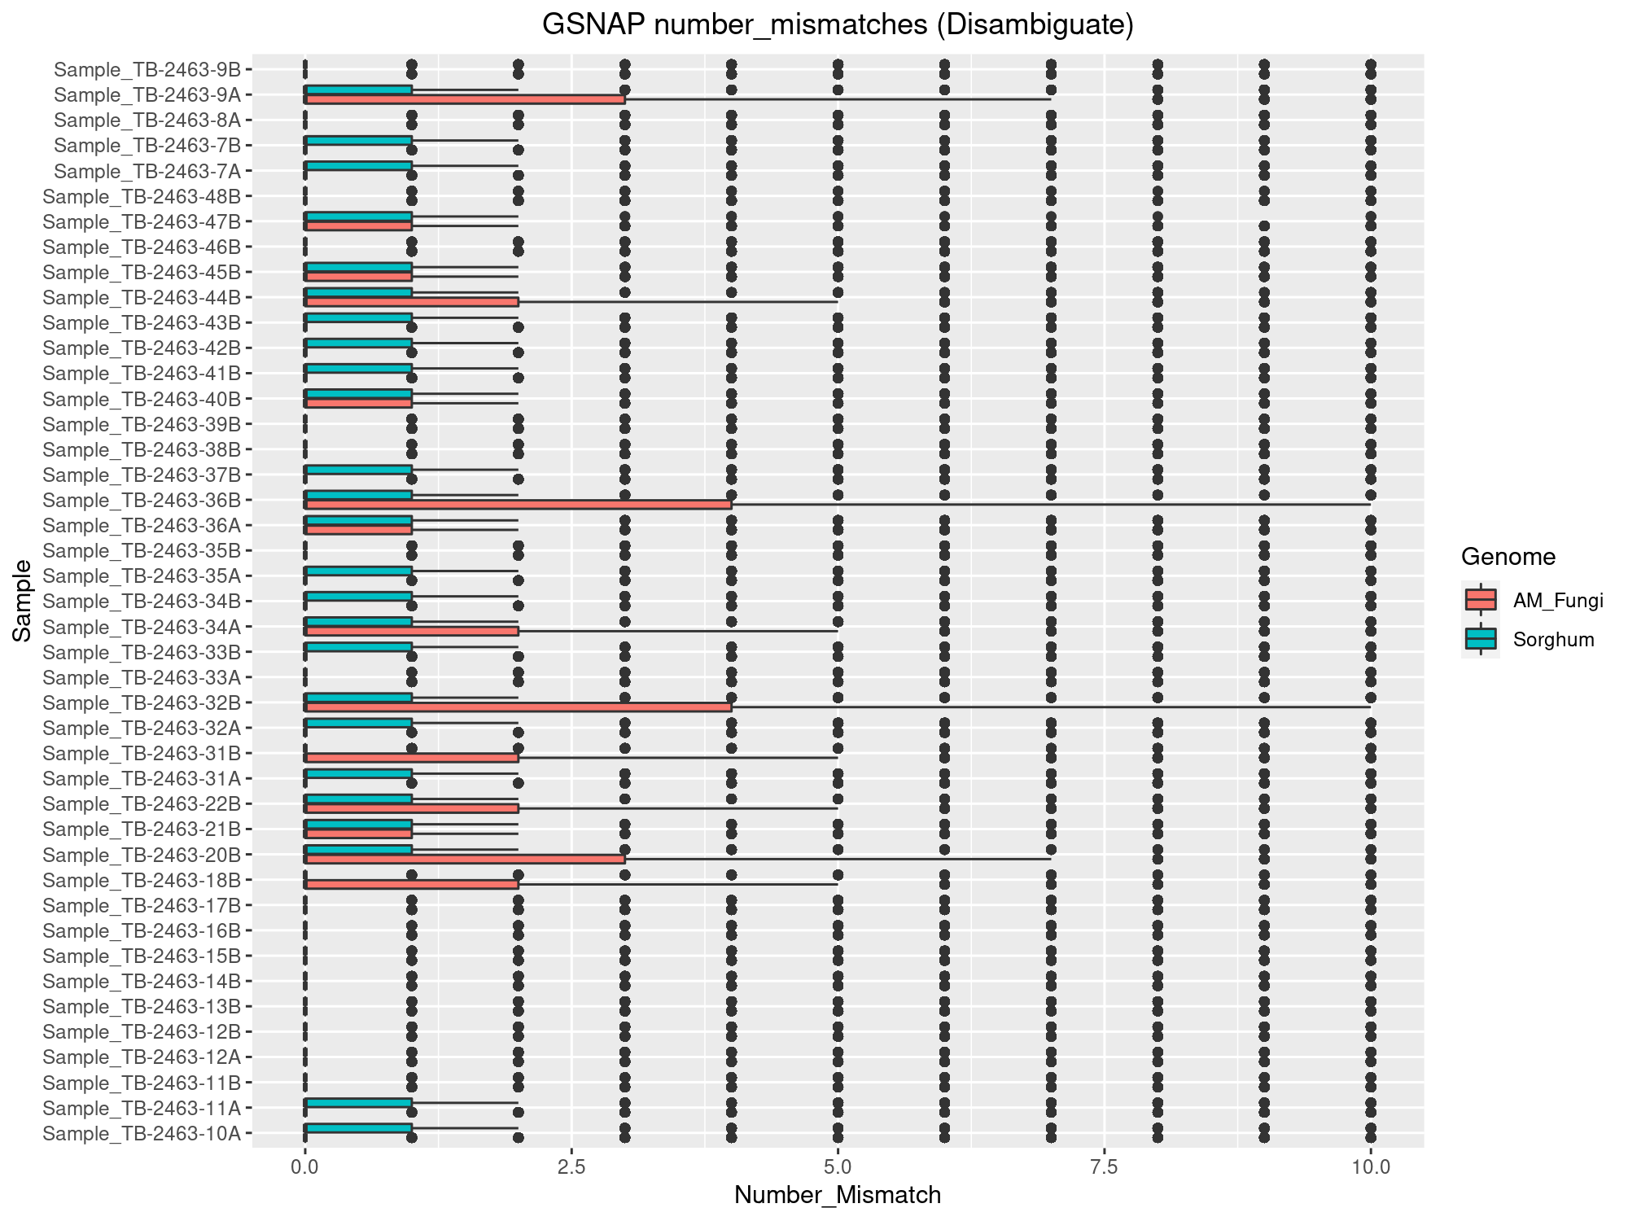
GSNAP ➔ Disambiguate ➔ QoRTs

Slide 9
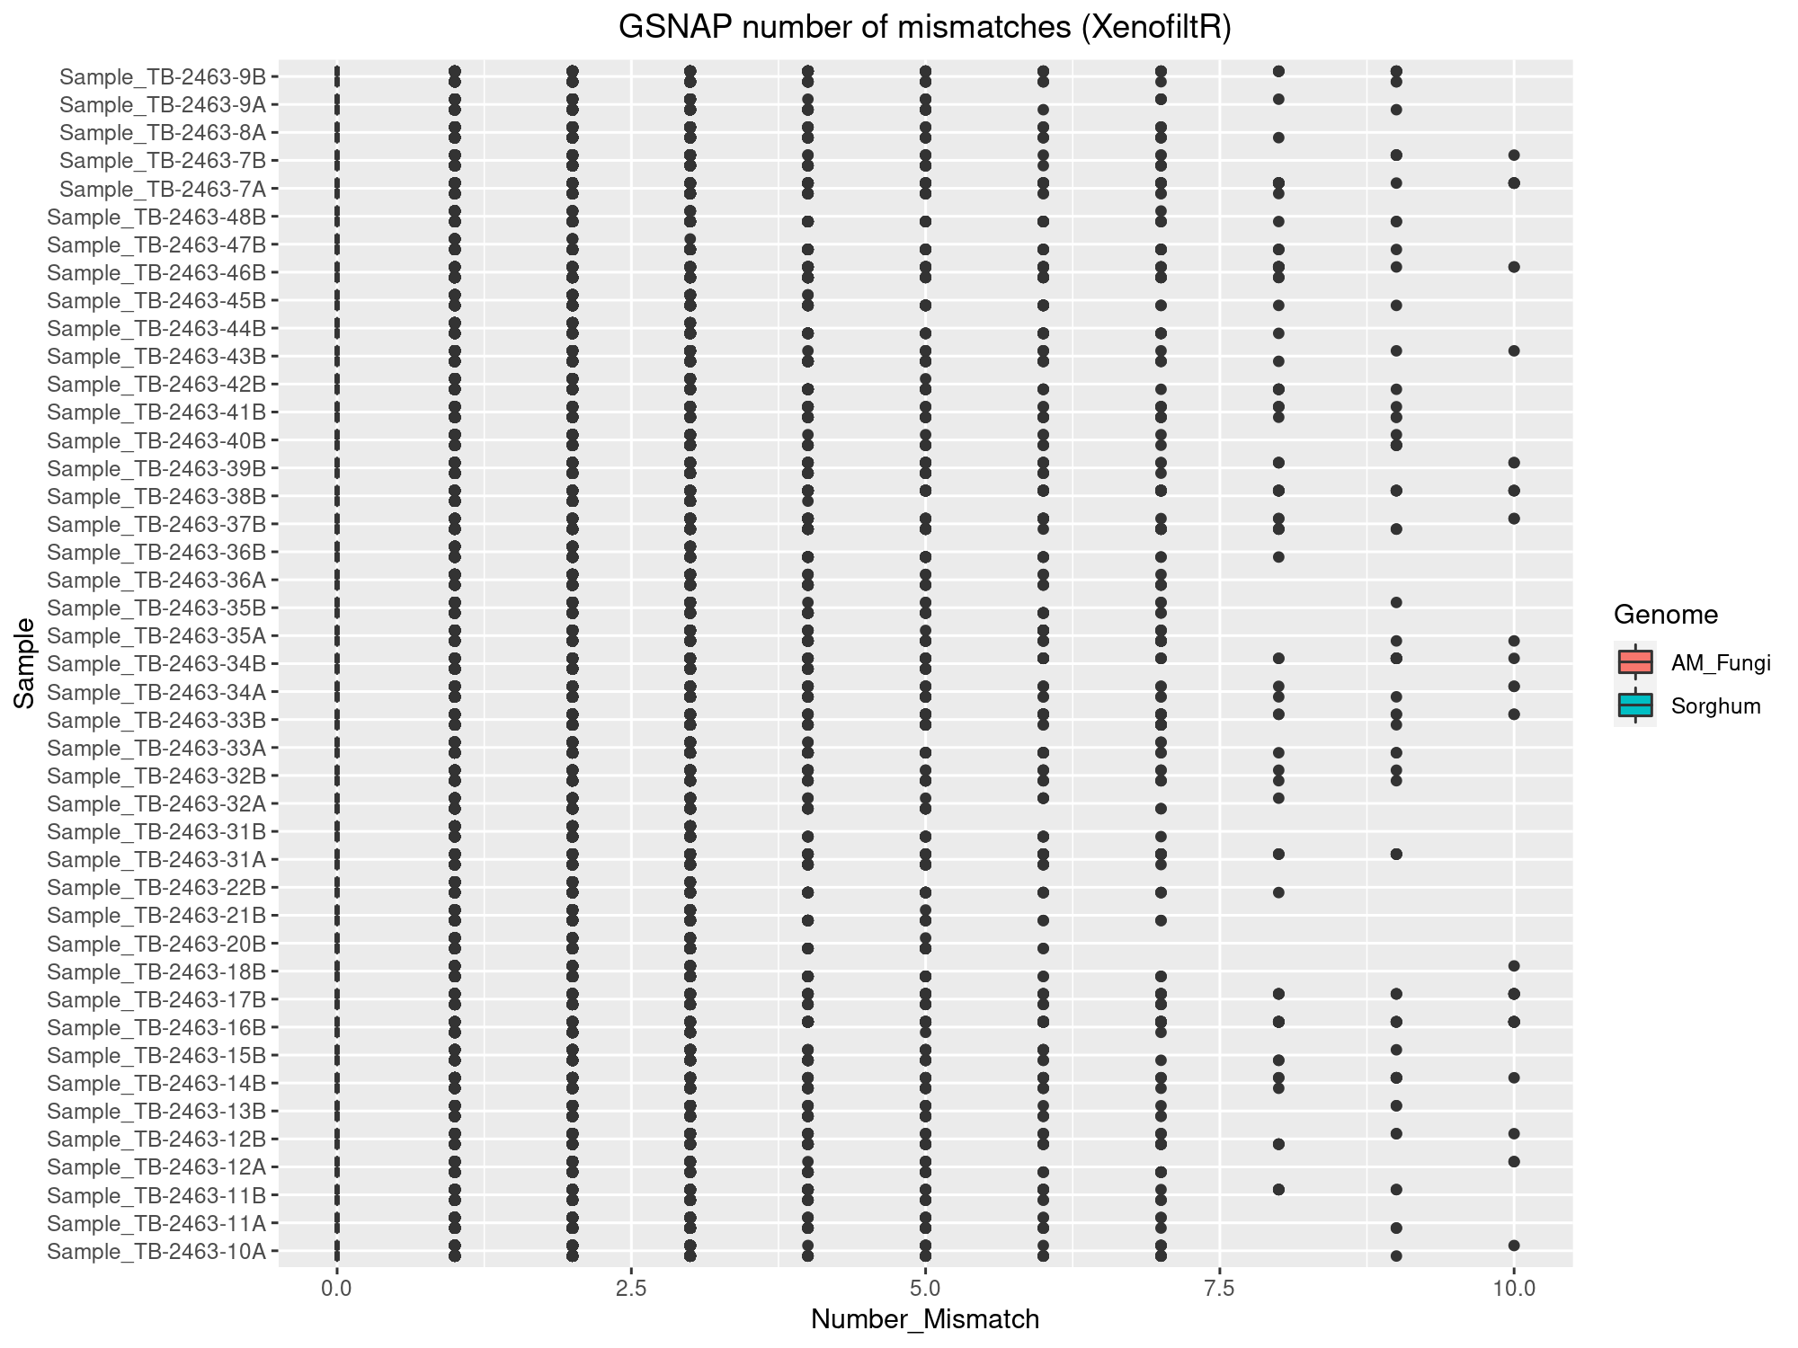
GSNAP ➔ XenofiltR ➔ QoRTs

Slide 10
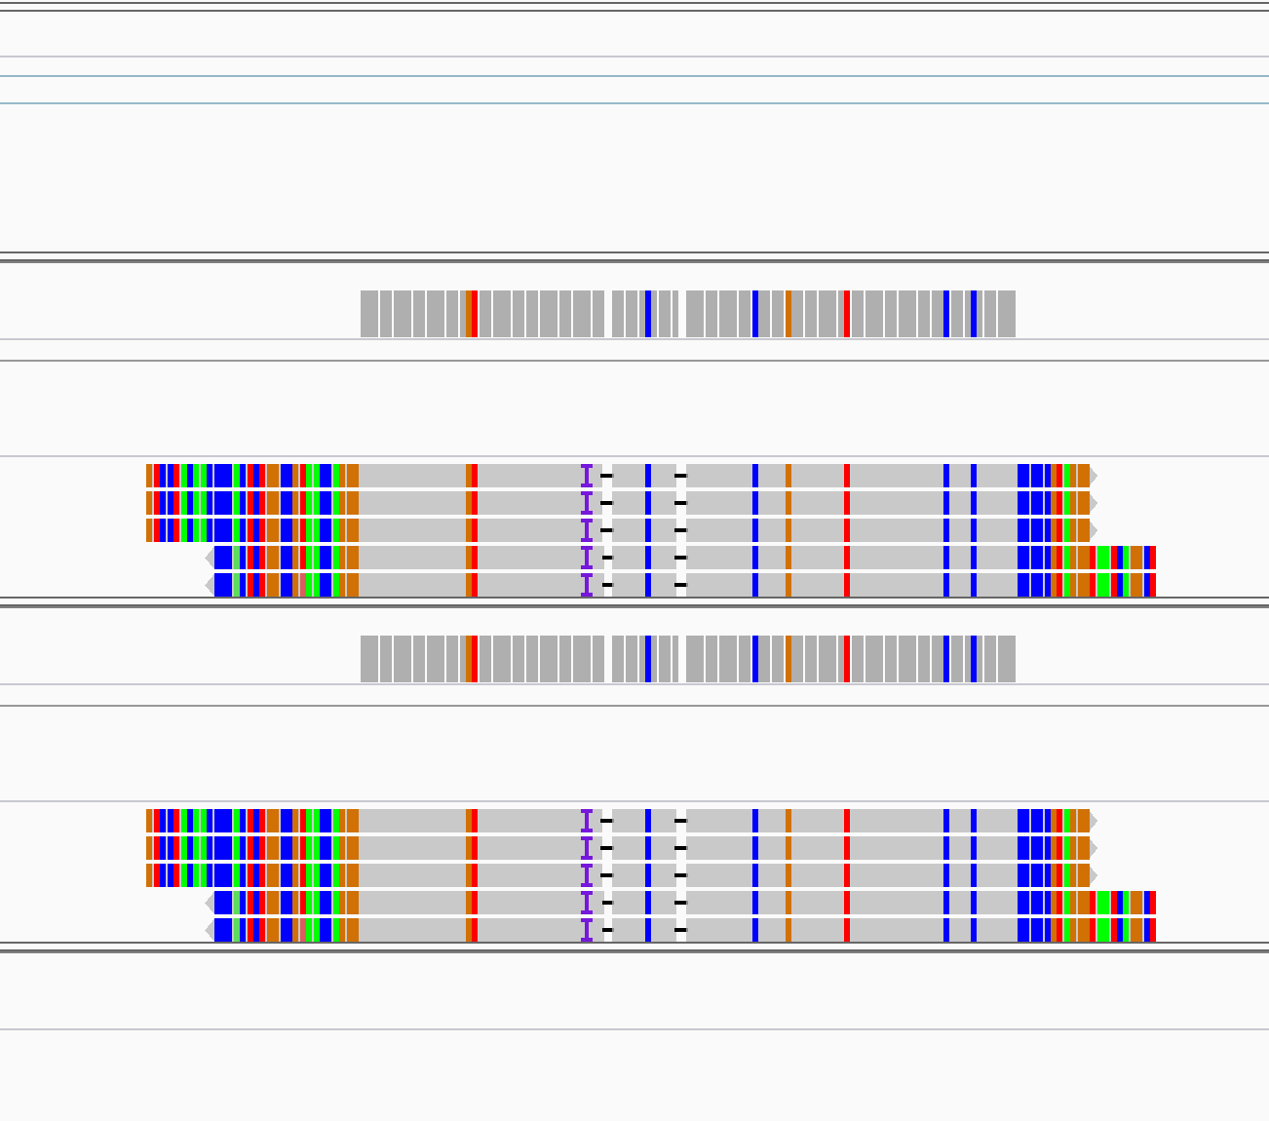
Examples
STAR_Disambiguate
GSNAP
_Disambiguate
STAR
GSNAP
GSNAP_Disambiguate
GSNAP_XenofiltR
mapQ~37
Examples on IGV:
scaffold_943:15,727-16,534
scaffold_660:23,643-25,283

Slide 11
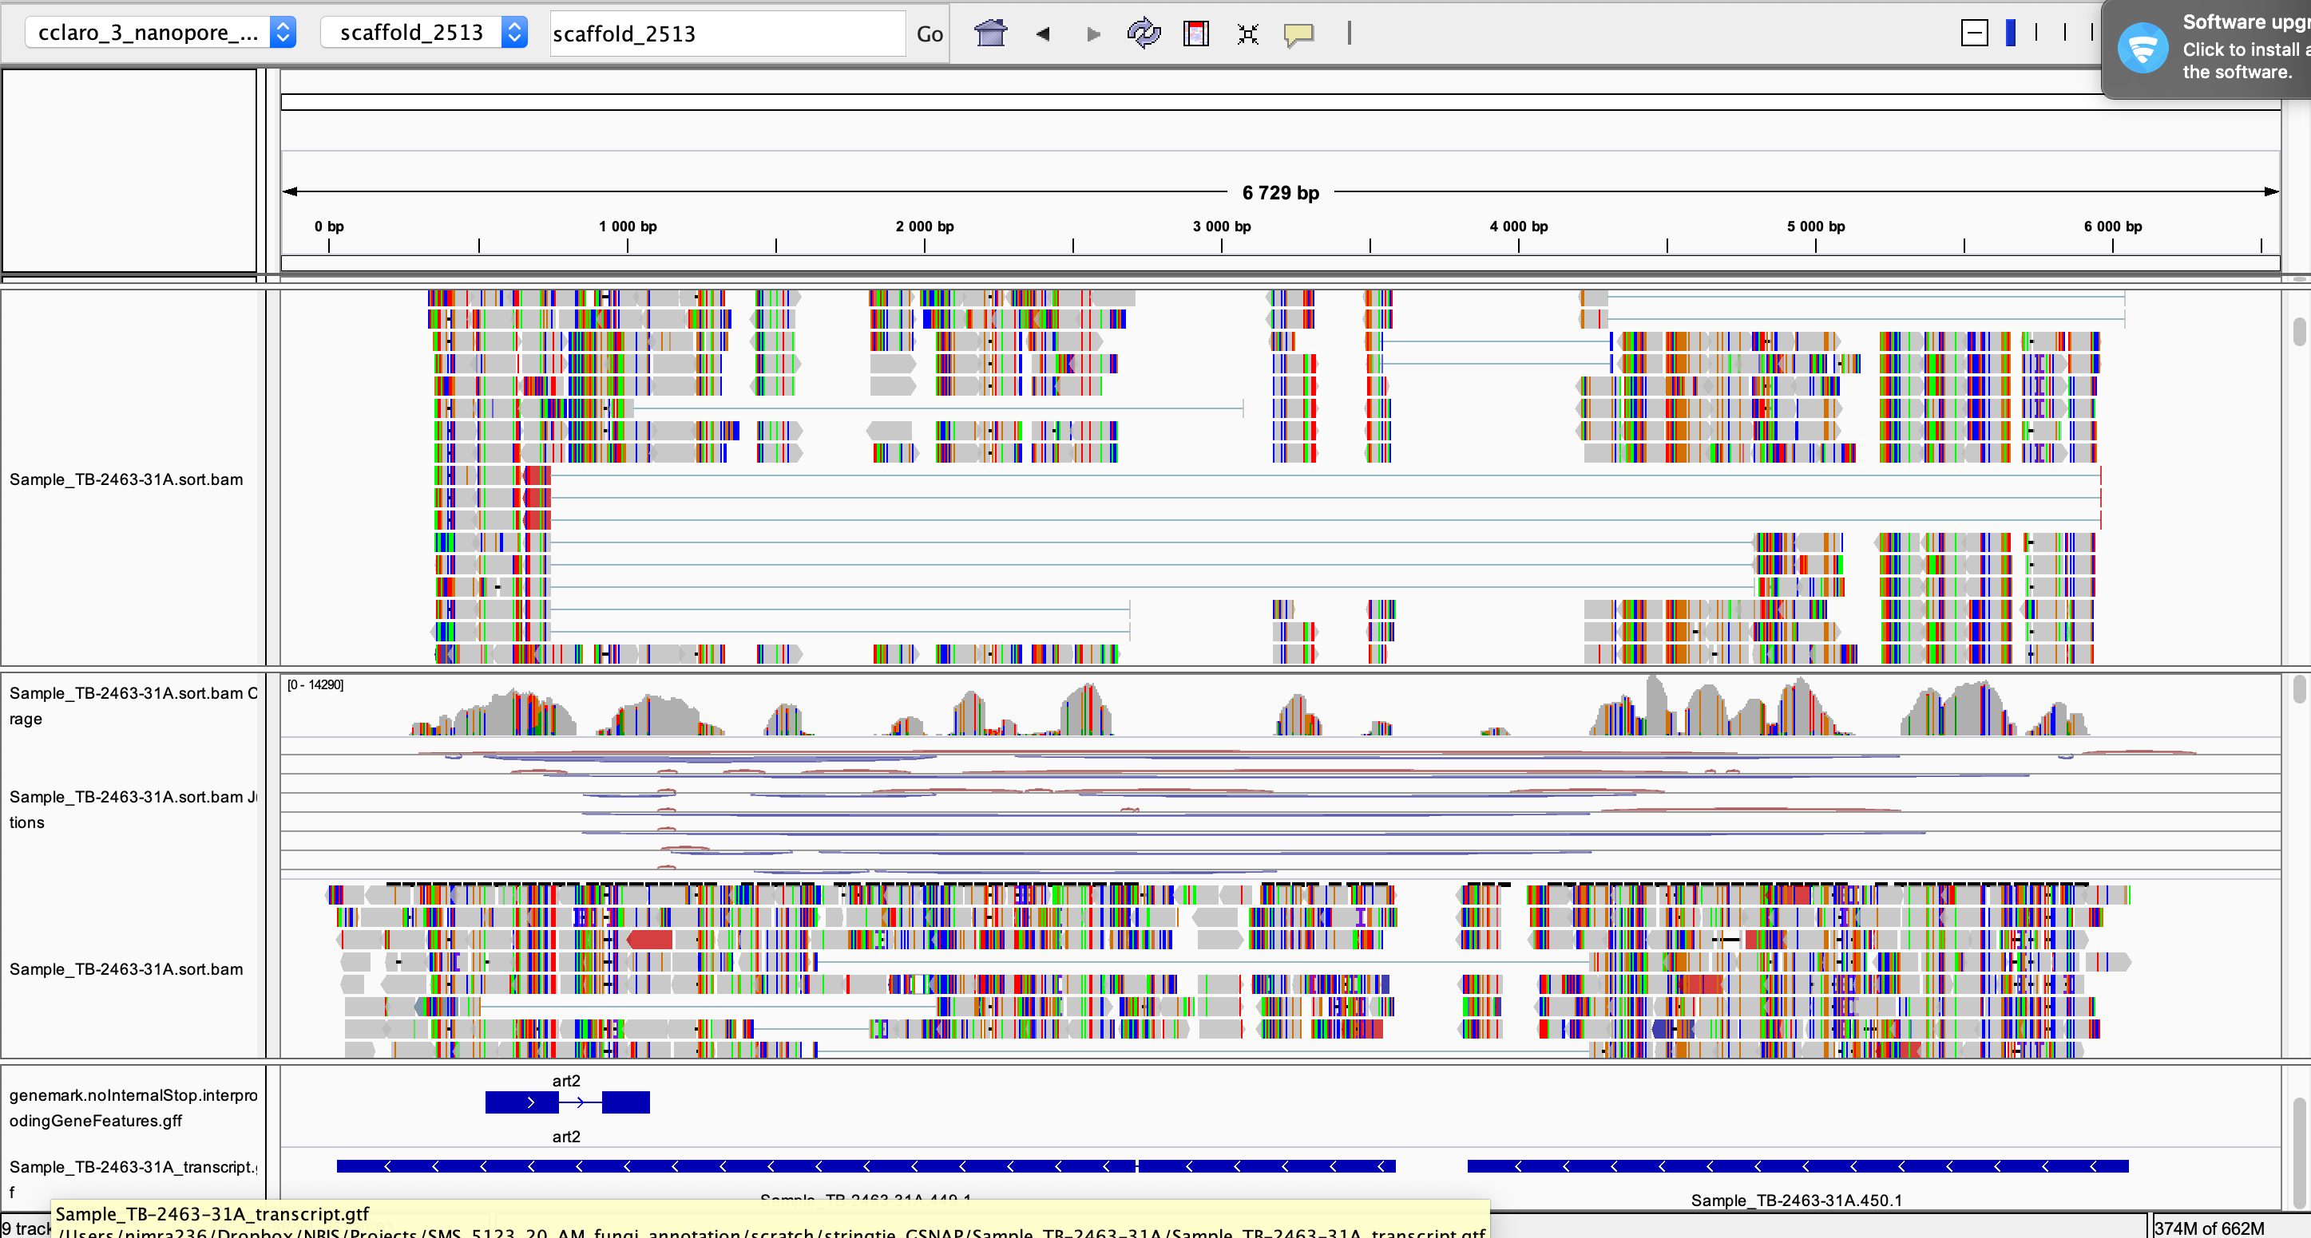

Slide 12
Comparison of transcroptome assembly with syn/nonsyn mutation
There are 79 records annotated with syn/non_syn mutation which do not overlap with annotation file?!
/crex/proj/uppstore2017083/David/gatk/SNP_pos/3N/cclaro_N.final.recode_not_in_annotation.bed
There are only potentially 28 novel transcripts/genes
There are only potentially 88 novel exons

Slide 13
Assembly_1

Slide 14
Workflow
Reads
Transcriptome assembly
(StringTie)
AM_Fungi
Assembly_1
Sorghum
Merging assemblies
XenofilteR
MM_threshold = 16
Expression
(featureCounts & edgeR)
(QC)
AM_Fungi
Assembly_1
Sorghum

Slide 15
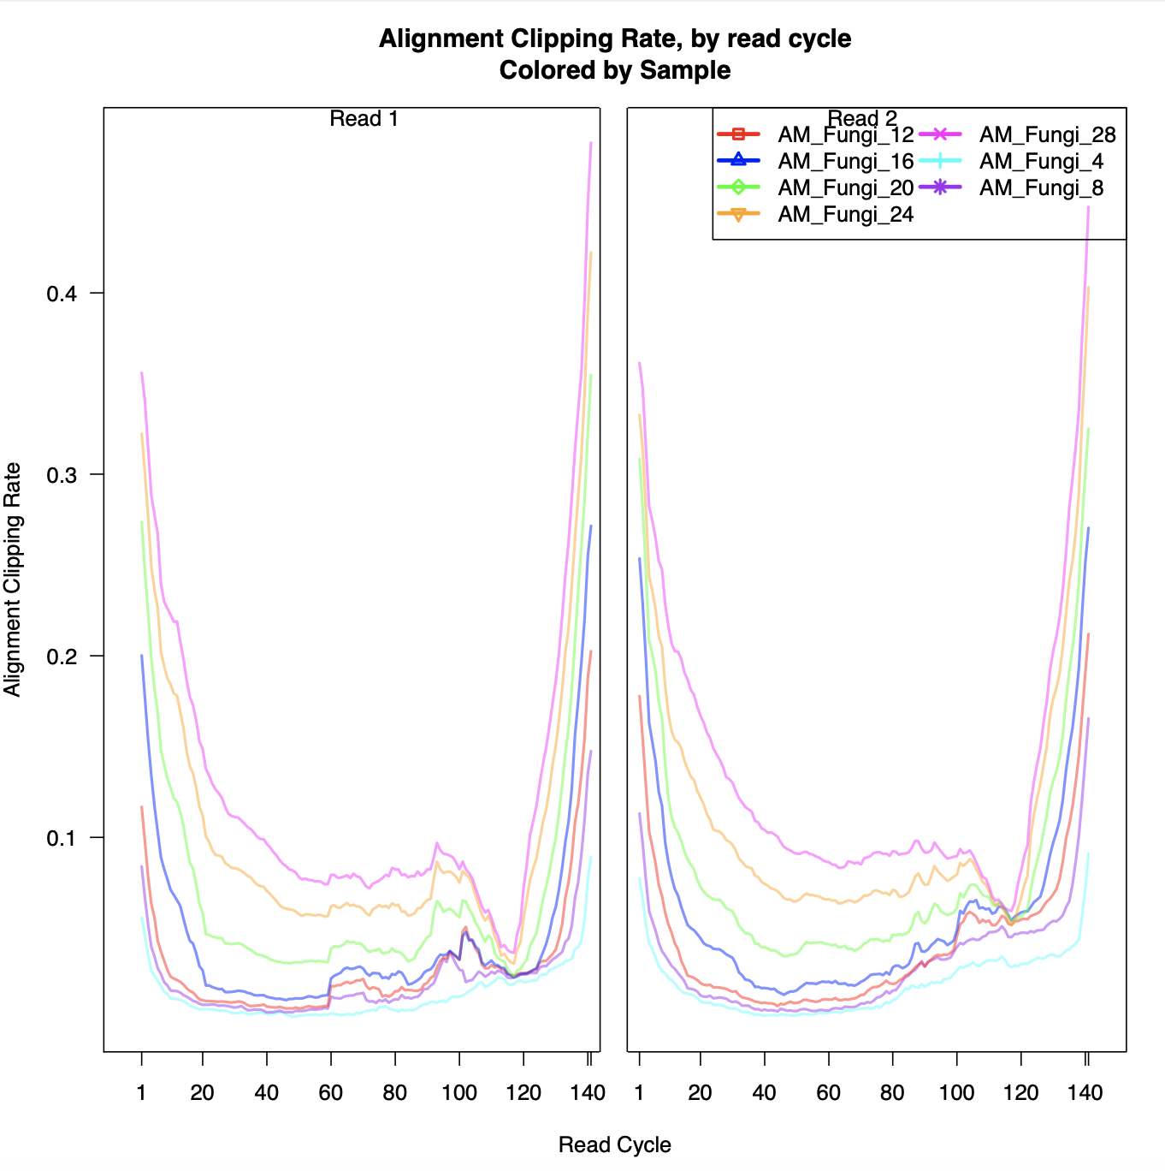
GSNAP ➔ XenofilteR ➔ QoRTs

Slide 16
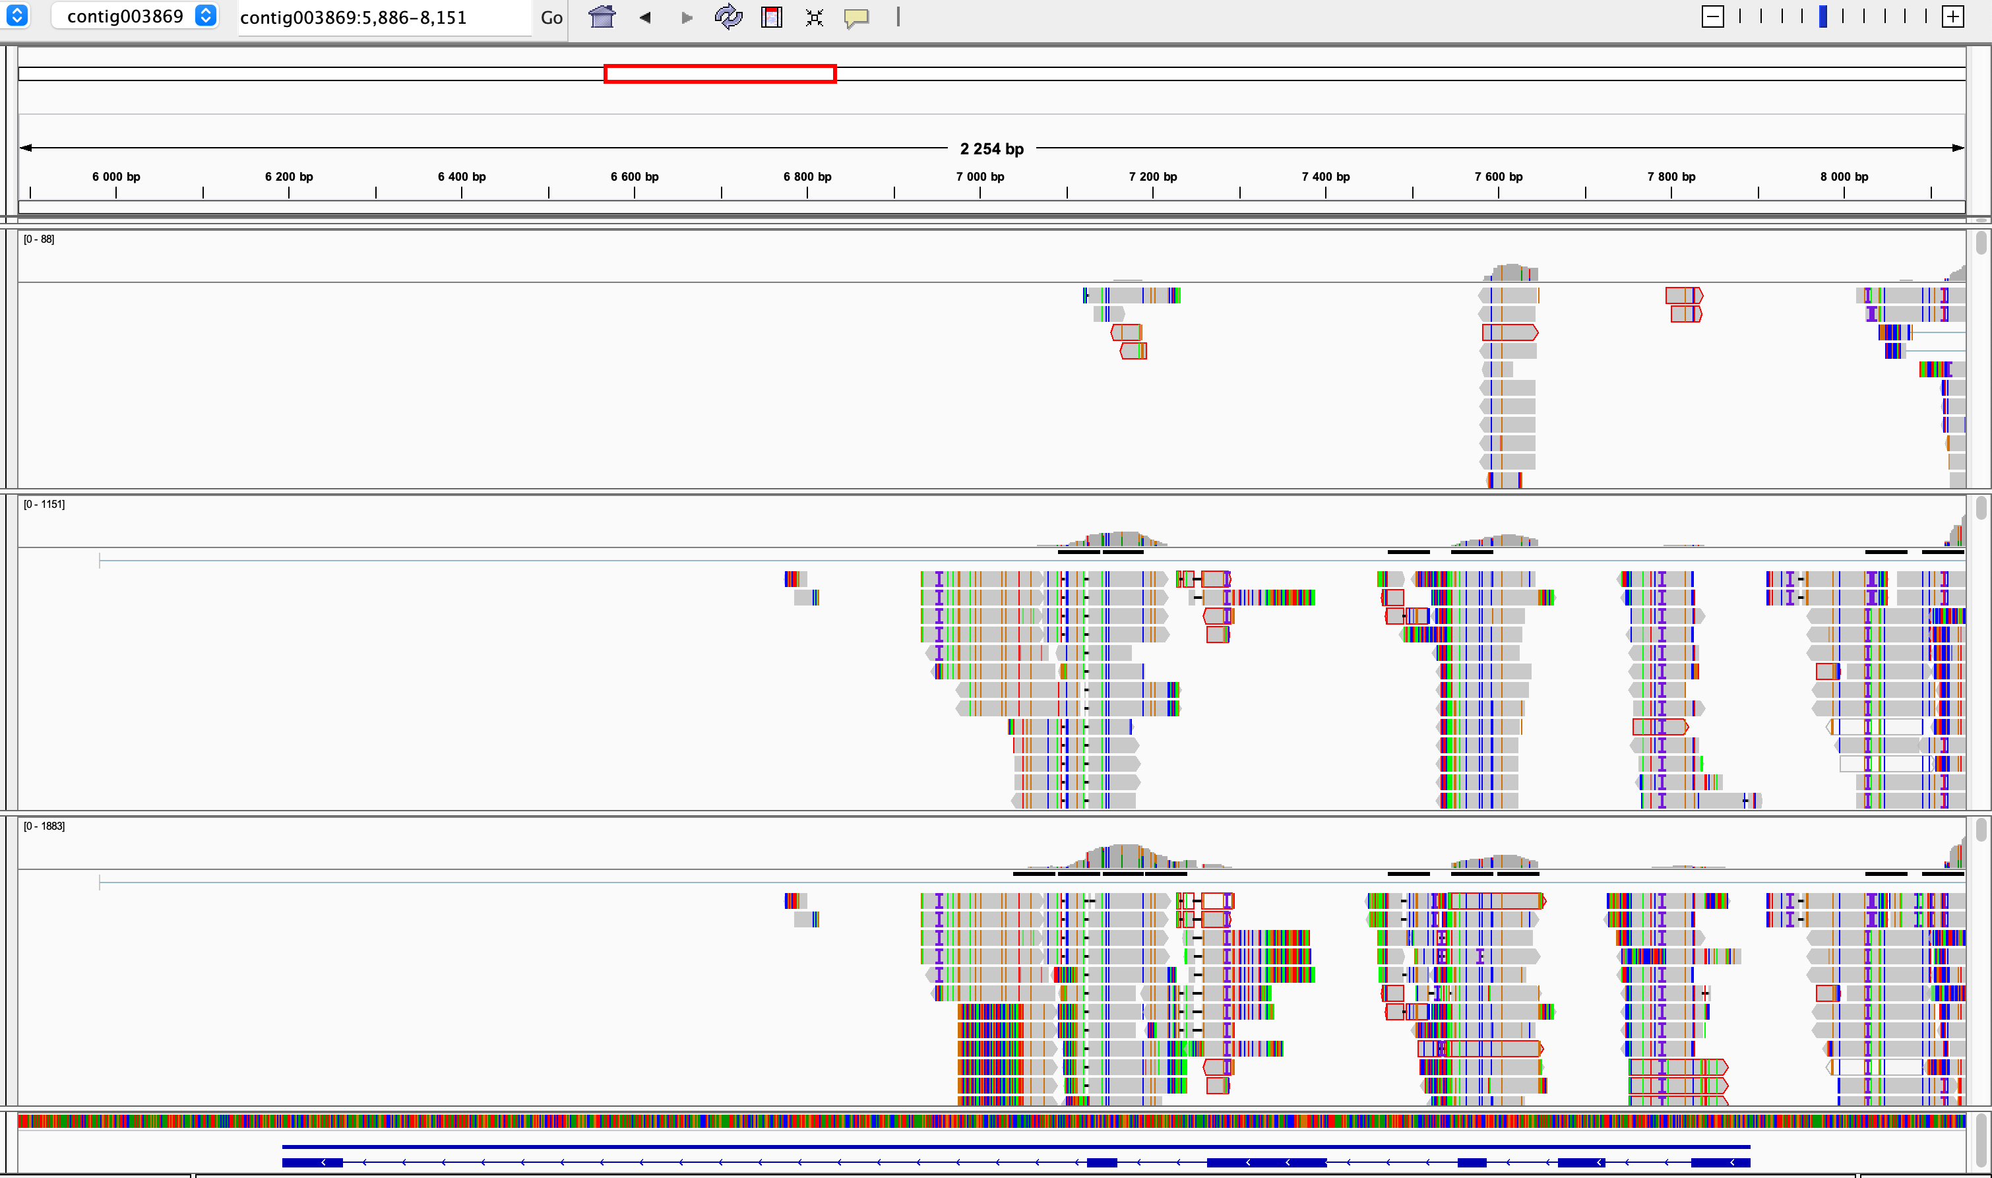
GSNAP ➔ XenofilteR ➔ QoRTs
MM_Threshould = 4
MM_Threshould = 16
MM_Threshould = 28

Slide 17
Transcriptome assembly
StringTie + funannotate
There are 28 novel transcript/gene

Slide 18
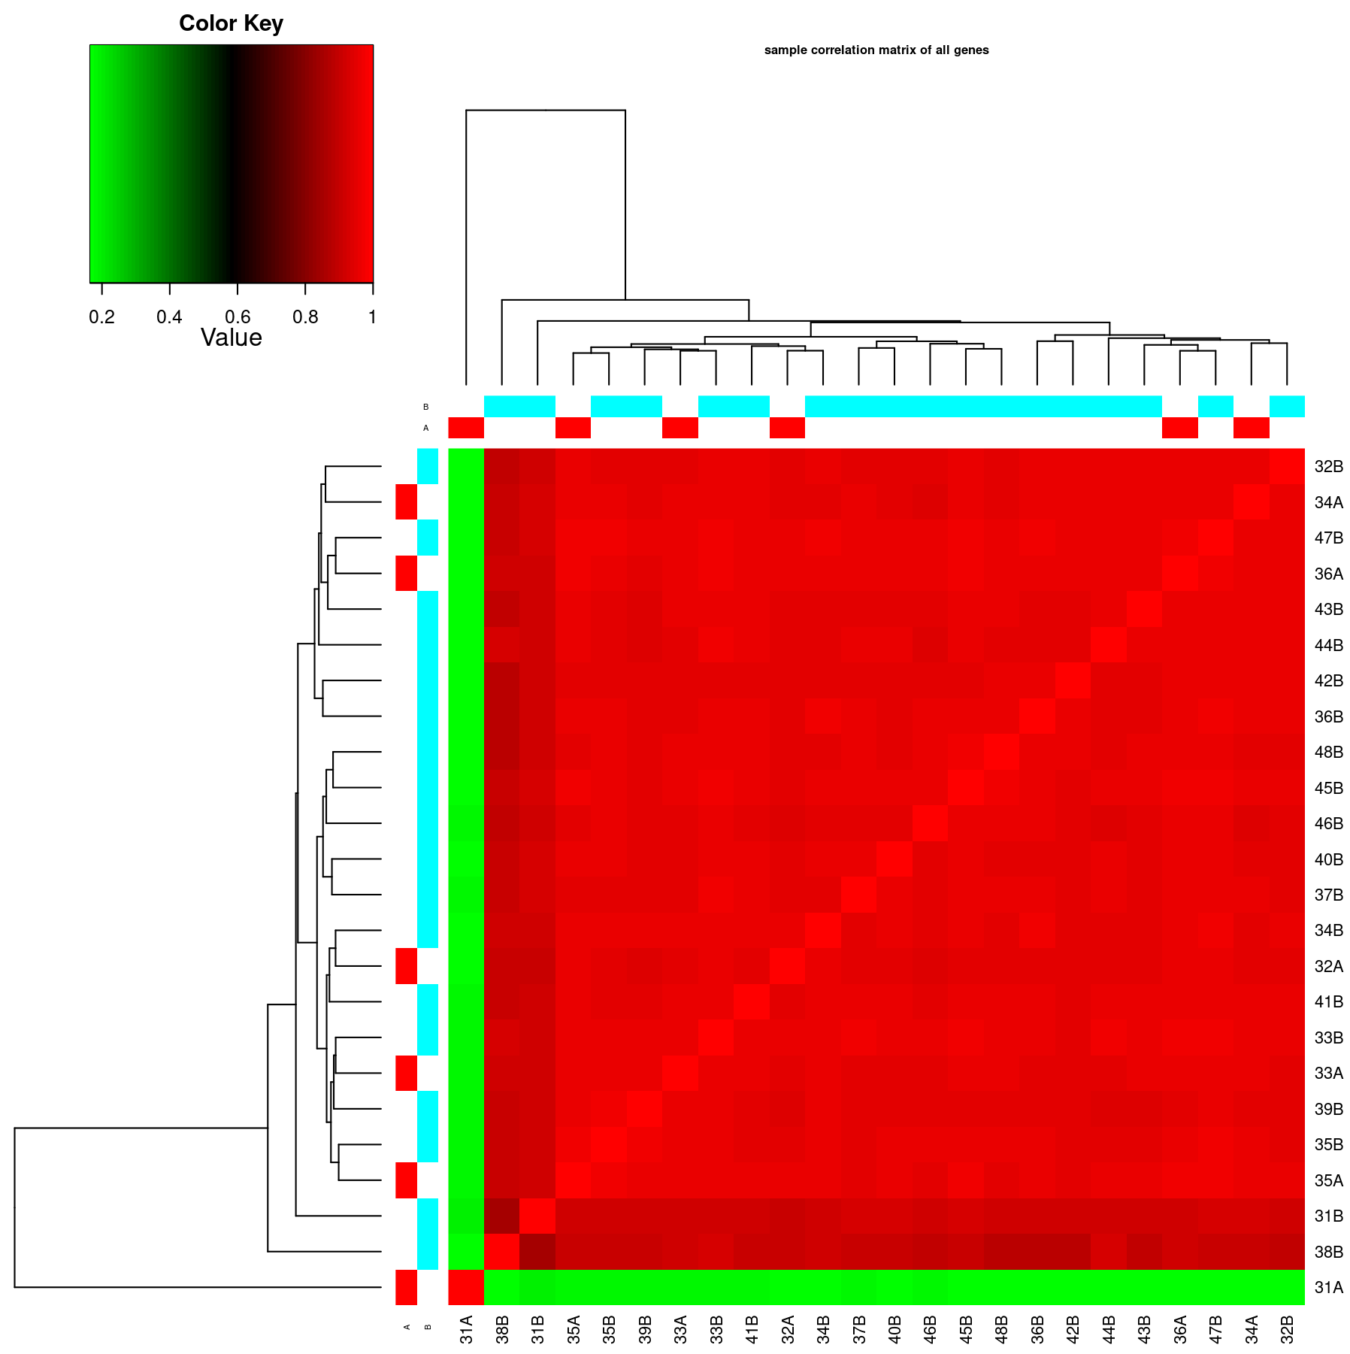
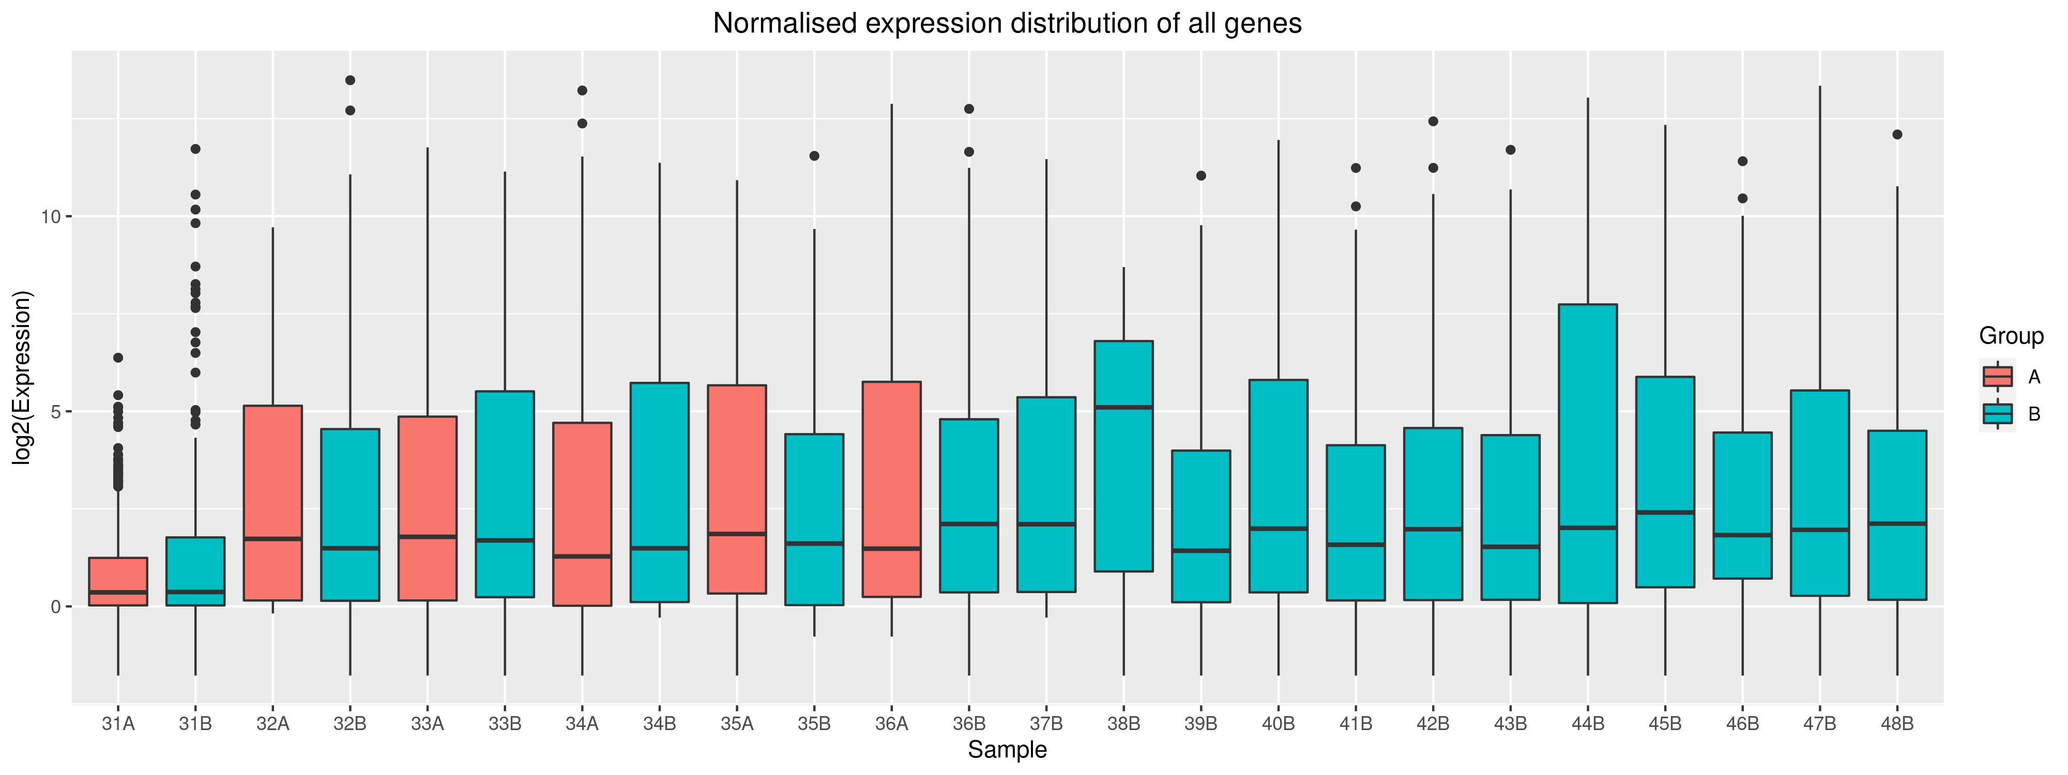
Expression analysis
Extracting gene expression by featurecounts requiring mapping quality above 20

Slide 19
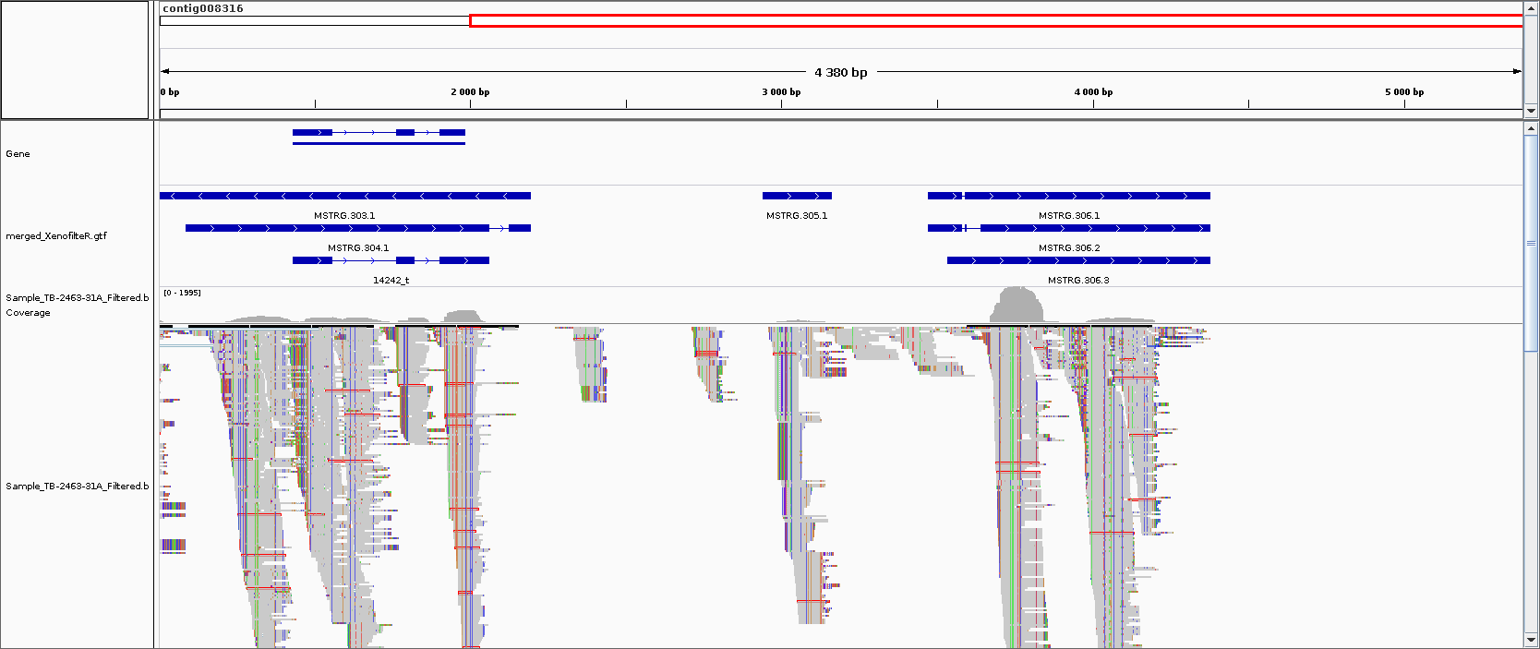
Expression analysis
There are only 89 genes where the normalised expression among all samples are > 10.
Funannotate
Transcript assembly

Slide 20
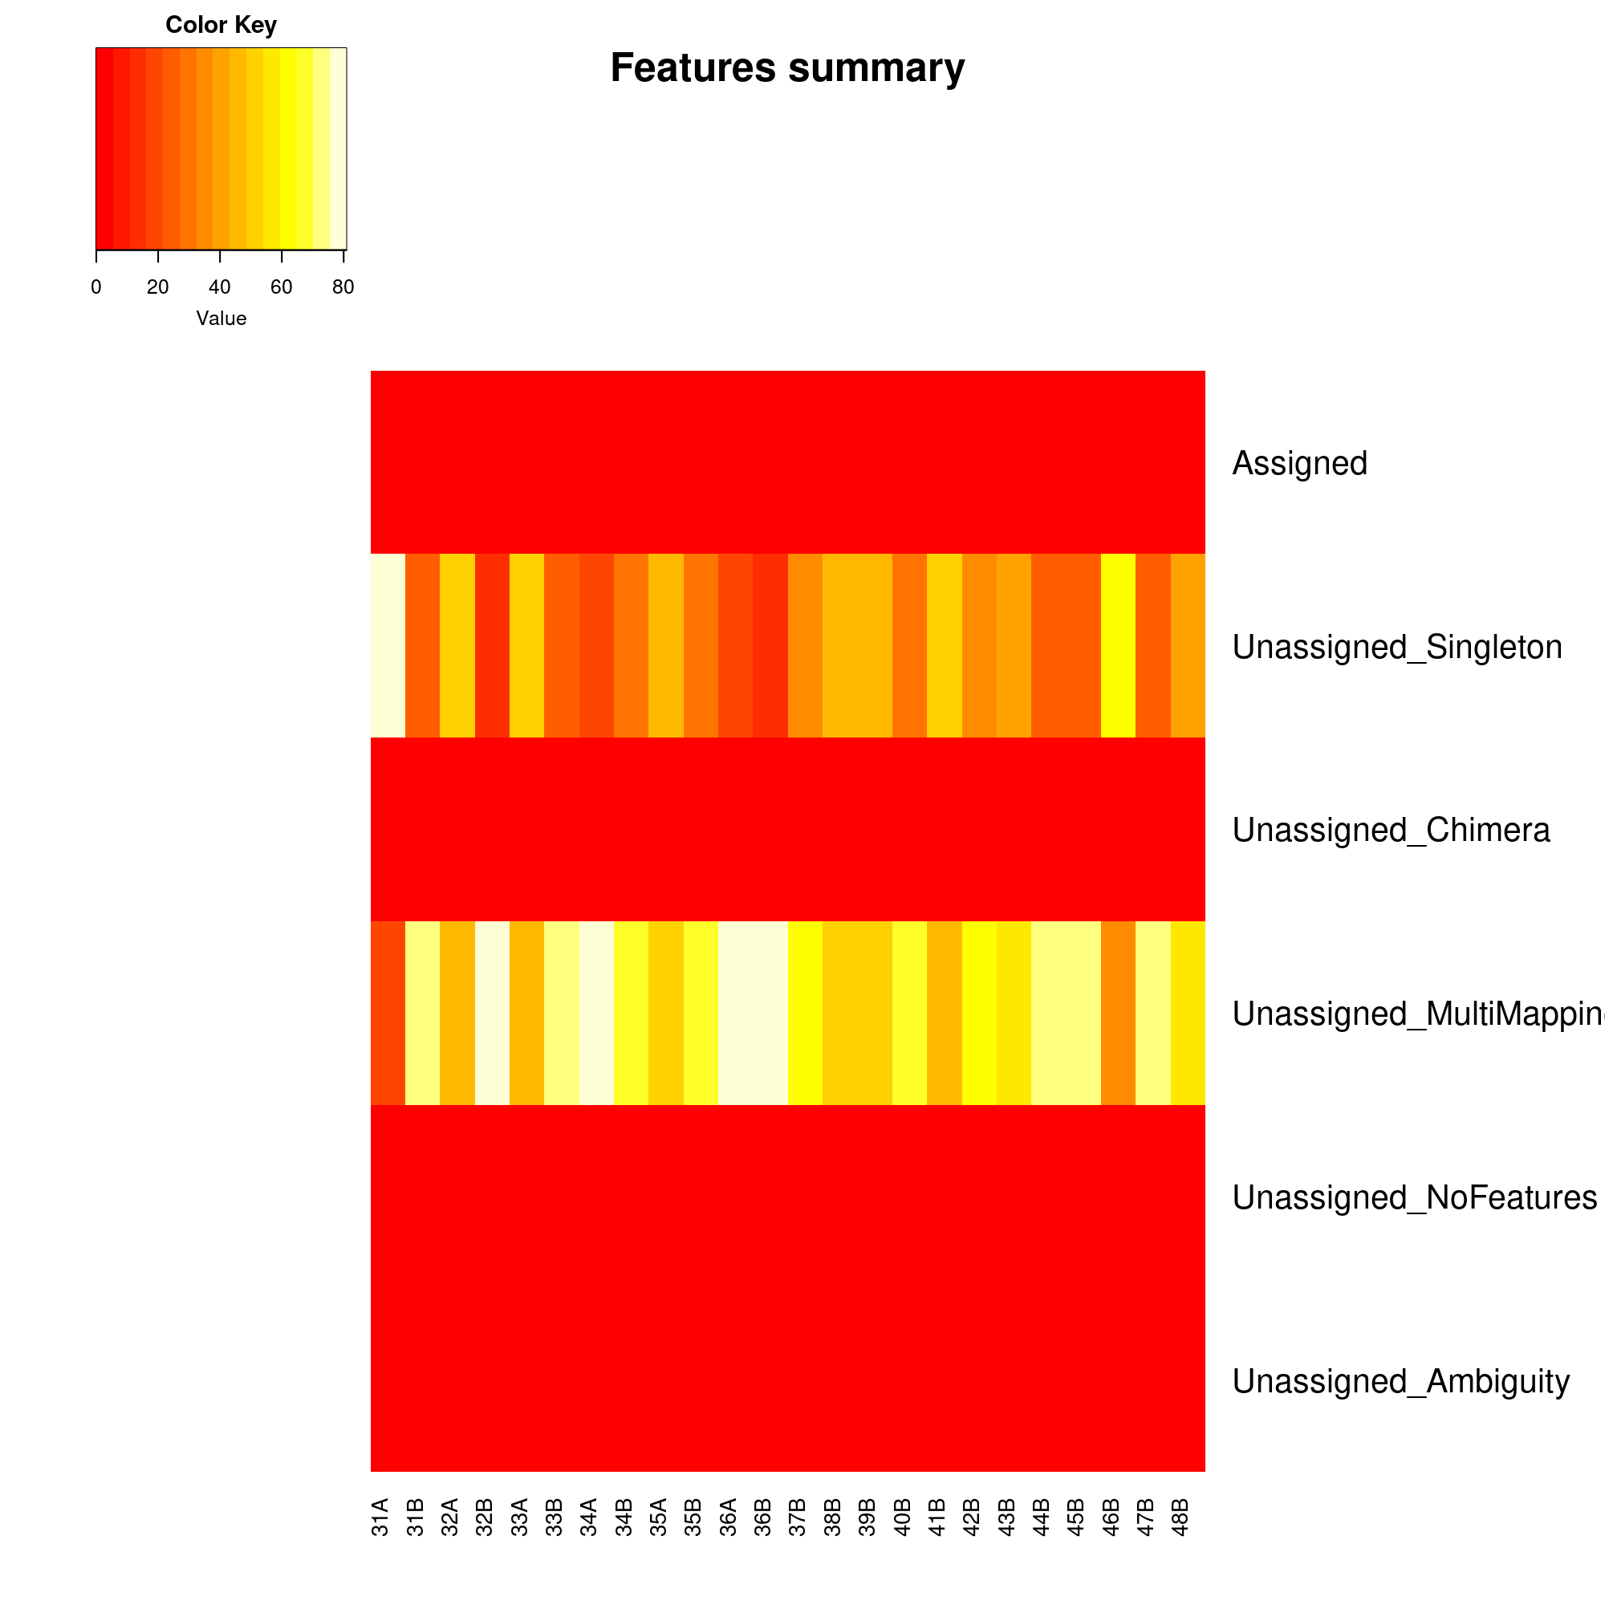
Expression analysis

Slide 21
Conclusion
New pipeline has helped to rescue reads with proper alignment on AM_fungi genome
There are 28 novel transcripts/genes identified using assigned reads to AM_fungi genome
Small fraction of reads are assigned to features (genes) which may not be enough for downstream DE analysis.

